Slide 1
Managing negotiation
Helen Peng

Slide 2
01
Contents
Process of Conflict
Types of Conflict
Dynamics of Conflict

Slide 3
Process of Conflict
Conflict is a part of life. Inside and outside the organization people are being constantly subjected to conflict. Conflict surface due to limitation of resources, competition and differences in values, goals, attitudes, expectations, etc.
What is conflict? It is defined as “A process in which an effort is purposely made by A to offset the effort of B by some blocking that will result in frustrating B in attaining his/her goals or furthering his/her interests.
Conflict also could be defined as the actual or threatened use of force in any continuing social relationship. Force is the attempt to override opposition by an act designed to produce injury to the other party.
The various attempts to understand the conflict show that the conflict does not emerge all of a sudden.

Slide 4
Process of Conflict

Slide 5
Process of Conflict
Stage I- Potential Opposition
Communication: The potential for conflict increases, when either too little or too much communication takes place.
Structure: Including variables: size, degree of specialization in the tasks assigned to group members, jurisdictional clarity, dependence between groups, etc.
Personal variables: The evidence indicates that certain personality types- for example, individuals who are highly authoritarian and dogmatic and who demonstrate low esteem- lead to potential conflict. The differing individual value system contributes for social conflict.

Slide 6
Process of Conflict
Stage II- Cognition and Personalization
Now it becomes actual conflict. The antecedent conditions can only lead to conflict. It is necessary for one or more of the parties to be aware of the existence of the antecedent conditions when individuals become emotional involved, so that parties experience anxiety, tenseness, frustration or hostility.
Stage III- Behavior
The conflict behavior could be overt or covert. Overt conflict covers a full range of behaviors from subtle, indirect, and highly controlled forms of interference to direct, aggressive, violent, and controlled struggle.

Slide 7
Types of conflict
Perceived Conflict: There is a potential ground for perceived conflict to turn into real conflict.
Latten Conflict: The fact that conflict the parties do not show it openly.
Manifest Conflict: Expressing conflicts explicitly or openly.
Line and Staff Conflict : Conflicts arise between line and staff managers over many issues.
Organized and Unorganized Conflict : When parties view that organized conflict cannot bring solution they take on to unorganized conflict. For example: absenteeism, late coming, turn over are termed as unorganized conflict.

Slide 8
Types of Conflict- conflict processes I

Slide 9
Pondy’s Model of Conflict
Conflict processes I
Latent conflict
Perceived conflict
Felt conflict
Manifest conflict
Conflict aftermath

Slide 10
Types of Conflict- conflict processes II

Slide 11
Donelson Forsyth’s 5 stage conflict resolution process
conflict processes II
Disagreement
Confrontation
Escalation
De-escalation
Resolution

Slide 12
Dynamics of Conflict

Slide 13
Dynamics of conflict
Parameters | Too Little Conflict | Appropriate Conflict | Too much Conflict
Information and new perspectives | Suppressed to preserve harmony | Closely examined and debated | Distorted to fit party benefits
Energy available for problem-solving | Low used for understanding the task | High. Used for understanding the task | Low. Used for attack and defense
Basis of decisions | Poor information. Low energy, low creativity | Accurate information, high energy, high creativity | Distorted information, high but antagonistic energy, low creativity
Extent of Conflict:
* Sometimes, emotions behind the differences among parties make the expression of conflict quite intense and visible.
* Seeing conflict as a legitimate mutual problem to be resolved in a collaborative mode.

Slide 14
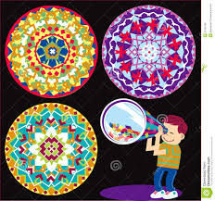
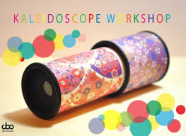
Dynamics of Conflict
Conflicts vary kaleidoscopically. Too much and too little conflict can have self-reinforcing effects. Distorted communications, stereotypes of the other party and associated actions tend to escalate either conflict or collusion.

Slide 15
Dynamics of Conflict

Slide 16
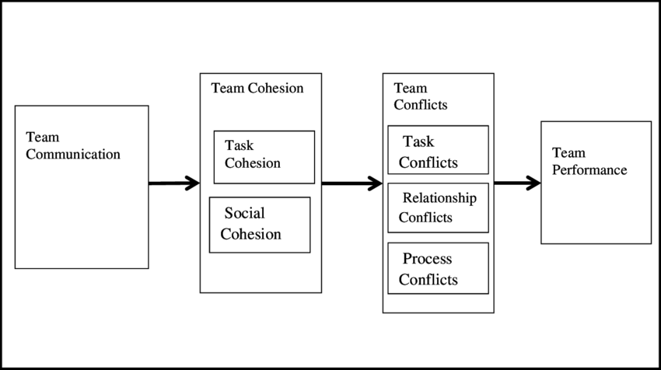
Dynamics of Conflict

Slide 17
Three categories of conflict
Conflict is inevitable, and agreement is impossible.
Conflict is not inevitable, yet agreement is impossible.
Although there is conflict, agreement is possible.

Slide 18
Matrix of conflict behavior
 | Conflict inevitable, Agreement Impossible | Conflict not inevitable, yet Agreement not Possible | Although there is conflict, Agreement is possible
Active Response | Win-lose power Struggle | Withdrawal | Problem-solving | High Stakes
 | Third-Party judgment | Isolation | Splitting the difference (Compromise, Bargaining, etc.)
Passive Response | Fate | Indifference or ignorance | Peaceful co-existence (Smoothing over) | Low Stakes

Slide 19
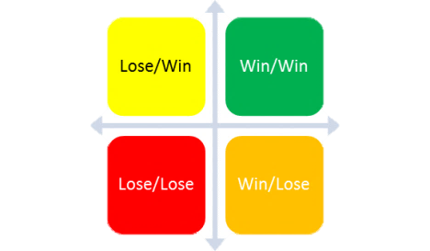
Win-Lose Matrix
Conflict Stakes and Behaviors
Conflict outcomes
The parties may decide to live with the conflict.
One party may triumph and force its solution on the other.
There may be a constructive, mutually acceptable resolution.
The outcome depends on the two most important being:
Attitude of the parties towards each other.
Importance to each party of the issues in conflict.

Slide 20
Effects of completive conflict
Some potential benefits of the inter-group conflicts
Group cohesiveness increases
The group becomes task-oriented
Leadership becomes more directive
Organizational structure becomes more rigid
Increase in loyalty and conformity
Groups become antagonistic toward each other
Perceptions are distorted
Communication virtually ceases
Conflict clarifies the real issue
Conflict brings real parties face to face
Conflict releases productive organizational energy
Conflict increases innovation
Inter-group conflict solidifies the group
Conflict serves as a catharsis
Conflict resolution solidifies inter-group relationships

Slide 21
Dealing with conflict Preventing dysfunctional conflict
Emphasize contributions to super ordinate goals rather than the immediate goals
Increase frequency of communication and interaction between parties
Reward collaboration
Expose parties to a wider range of experiences to broaden their base for empathy and understanding of inter-party problems.
Engage workgroups or functions in periodic “Work-outs” as some process-oriented organization do on a regular basis. “Work-outs” can bring to surface even emerging or minor conflicts for resolution, which may otherwise fester or flare up violently.

Slide 22
Conflict management strategies
The most difficult conflict to resolve are those arising our of VALUE DIFFERENCES. Vaues are our core-they are things we believe in.
The most important thing that can be done in such conflicts, is to understand the real differences, assess their contribution-positive and negative-to the organization’s chosen goals and strategies; and highlight such contribution to the parties in conflict.
Conflict resolution is seen as a process because conflicts do not go away.
Conflict resolution is process of joint exploration of real issues by the real parties.
The following ways are commonly used to deal with conflicts:
1. Avoiding: Withdraw from conflict situation, leaving it to chance.
2. Smoothing: generally cover up the differences and claim that things are fine.
3. Bargaining: Negotiate to arrive at a compromise and bargain for gains by both parties-usually a zero-sum game.
4. Problem Solving: Confront the differences and resolve them on a collaborative basis.

Slide 23
Dynamics of Conflict

Slide 24
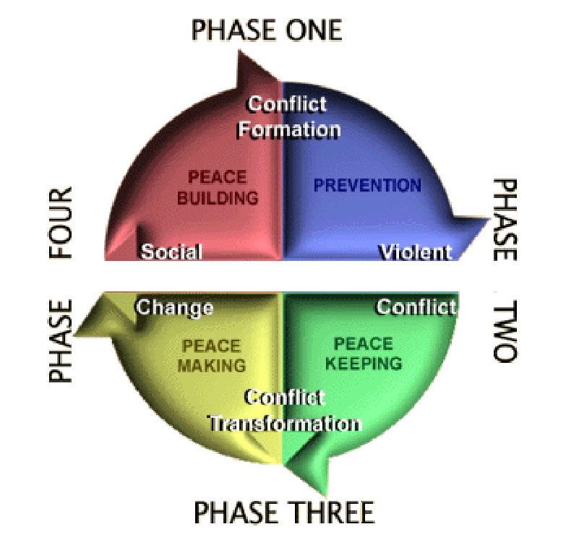
Dynamics of Conflict

Slide 25
Dynamics of Conflict

Slide 26
Assignment
Intervention for too much conflict:
A. Change the orientation of one party or both parties, to the conflict
B. Change the structure of the situation
C. Change the pattern of interaction between the parties
D. Change personal behaviors of he actors in terms of aggression, passivity or assertion in inter-personal or intra group relations.

Slide 27
Assignment
Intervention for too less conflict: People are generally socialized to avoid conflict. Manager put too much emphasis on harmony and peace. People are afraid of hurting others’ feelings.
Conflicts stimulations is needed:
Change orientation of the one part or both parties, to the conflict
Change the structure of the situation
Change the pattern of interaction between the parties
Change personal behaviors of he actors in terms of aggression, passivity or assertion in assertion in inter-personal or intra-group relations.

