Slide 1
Nature of conflict
Helen Peng

Slide 2
01
Contents
Features of Conflict
Levels of Conflict
Conflict Continuum
Perception of Conflict
Power Continuum
Functional and dysfunctional aspects of conflict
** Interpreting the lived-meaning of conflict-asking deeper questions about why it happens as it does- is a necessary precursor to determining how to act when you find yourself in a conflict situation.
--Kellett and Dalton

Slide 3
Creative resolution of conflict calls for a willingness to squarely confront the issues in conflict, a minimum level of trust in bona fide of the other party to conflict and the use of a rational rather than only the emotional approach.
Mature parties to a conflict are often able to see the super ordinate purpose and use creative problem-solving processes keeping that super ordinate purpose constantly in view.
Where situational requirements are unable to bring about the requisite conditions for creative conflict management, third parties may intervene.
Effective strategies:
Conflict is inescapable relationship…providing logic for mutually satisfactory, collaborative and developmental resolution of conflict.
Conflict grows out of similarities in the needs and values of parties…conflict can be resolved either enlarging resources, or by sharing and collaborating.
Conflict has roots in differing needs and values of interdependent people. A creative synthesis kind of resolution may give rise to a better understanding among persons with differing values and needs of each other’s perspectives.

Slide 4
Change leading to conflict: Conflict, change and development are thus closely inter-linked.
Conflicts, in aid of development, must be faced boldly, deliberately and as a preferred choice!
Often, conflicts hold opportunities for developmental interventions to be initiated.
Two basic assumptions:
1. Differences among people should not be regarded as inherently “good” or “bad”.
2. There is no one “right” way to deal with differences….on the basis of an insightful diagnosis and understanding of the factors with which he is faced at that time.

Slide 5
Features of Conflict
Conflict occurs when individuals are not able to choose among the available alternative courses of action.
Conflict between two individuals implies that they have conflicting perceptions, values and goals.
Conflict is a dynamic process as it indicates a series of events. Each conflict is made up of a series of interlocking conflict episodes.
Conflict must be perceived by the parties to it. If no one is aware of a conflict, then it is generally agreed that no conflict exists.
**All religions try to assist “conflict management” to self growth!

Slide 6
Finding a way out─認知心理學
心念轉一轉，世界大不同
你意非我意，我意非你意
你和我之意，未必何他意
你我他之意，是否合天意
若不合天意、世事難如意
主旨非我意
專心仰賴祢，不可倚靠自己的聰明
在一切所行的事上都要認定祢
祢必指引我的路

Slide 7
Perception of conflict
There have been different perception over the role of conflict.
Traditional view: Conflicts are considered bad and required to be avoided.
Human Relations view: Conflicts are bound to be there and management should always be concerned with avoiding conflicts.
Interactionist view (Modern view): Leader should allow some conflicts to happen in the group so that the group always remain viable- self- critical and creative.
Encouraging conflict
A positive force in a group and necessary for a group to perform effectively
The group may remain viable, self-critical and creative….to keep the group progressive and innovative
It must be kept under control to avoid their dysfunctional consequences

Slide 8
Functional and dysfunctional aspects of conflict
Functional conflicts
Dysfunctional conflicts
Release of Tension
Analytical Thinking
Group Cohesiveness
Competition
Challenge
Stimulation for Change
Identification of Weaknesses
Awareness
High Quality Decision
Enjoyment
High Employee Turnover
Tension
Dissatisfaction
Climate of Distrust
Personal vs Organizational Goals
Conflict as a Cost
**Conflicts may distract the attention of the members of organization from organizational goals. It seems personal victory becomes more important than the organizational goals.

Slide 9
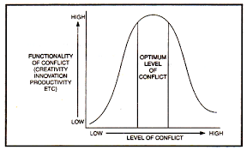
Level of conflict

Slide 10
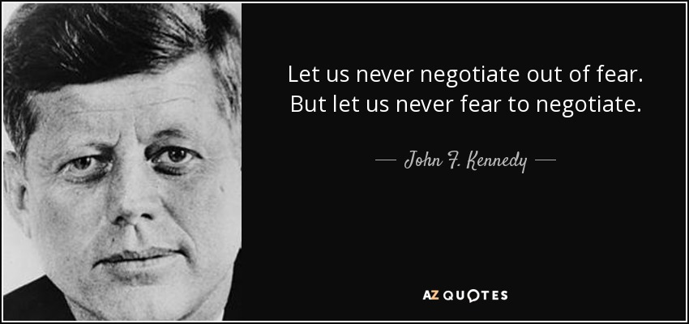
Managing conflict
Part I

Slide 11
Understanding Conflict
Levels of Conflict
Discomfort
Stay Alert
Incident
Misunderstanding
Tension
Crisis

Slide 12
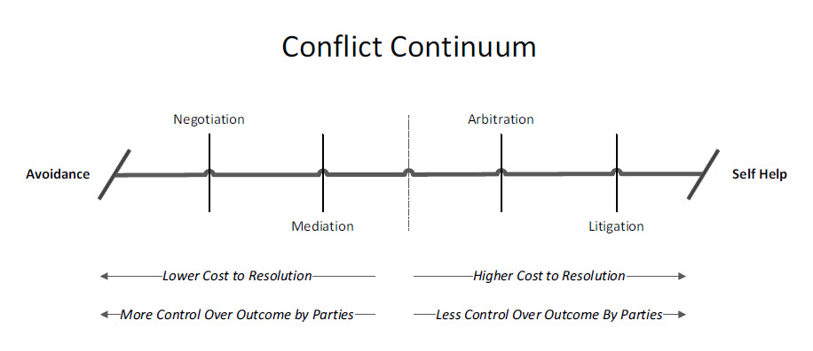
Conflict continuum

Slide 13
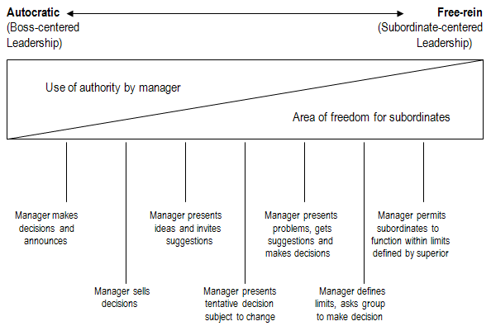
Continuum of leadership behavior

Slide 14
Power continuum

Slide 15
衝突狀況是一種學習
和而不同，勝過「同而不和」 “Well, I don’t agree with this but I accept it.”
覺察：See if you can locate along the Power Continuum the decision-making power in the groups, organizations or situations in which you're involved. Is your boss or supervisor a pure dictator? Is there a commission at your workplace that can suggest policy or listen to grievances? Are decisions in your family made by a single authority figure or a genuine consensus?
Understanding the prevailing decision-making dynamics is an important element in determining the most effective way in which to gather and utilize-information in your various environments, especially when you’re involved in an uncomfortable situation that could become one of the two things: a full-blown conflict or a harmonious working relationship.

Slide 16
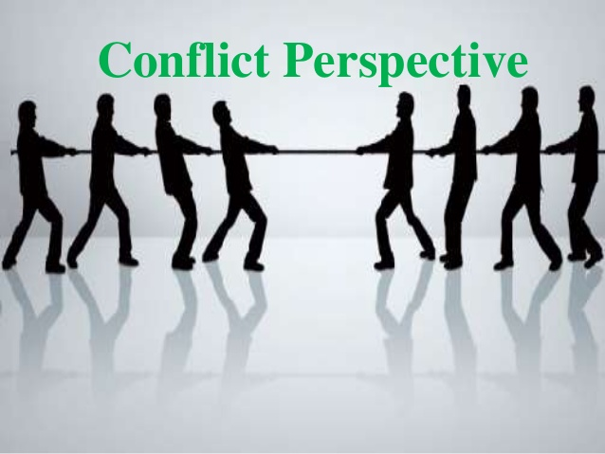
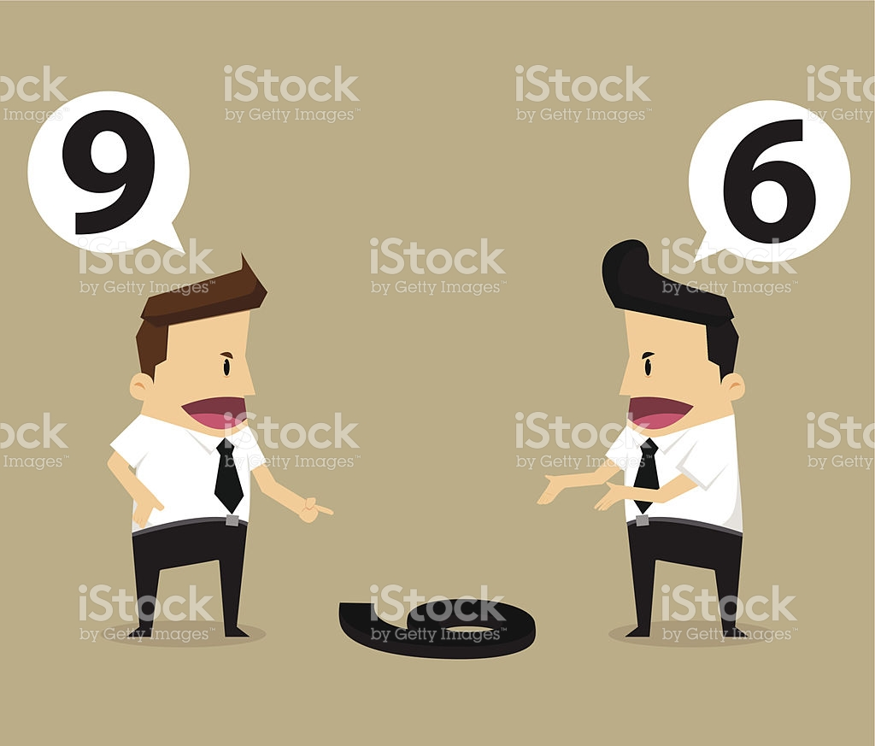
Managing conflict
Part I

