Slide 1
Role of power in negotiation
Helen Peng

Slide 2
Contents
Understanding Power

Slide 3
Understanding Power
In a broad sense, people have power when they have “ability to bring about outcomes they desire” or “the ability to get things done the way (they want) them to be done” (Salancik and Pfeffer, 1977)
The ability to do or act or accomplishing something.
Power is at the root of negotiating success.

Slide 4
Understanding Power
Why is power important to negotiators?
Most negotiators believe that power is important in negotiation because it gives one negotiator an advantage over the other party.
Seeking power in negotiation usually arises from one of two perceptions:
When the negotiator believes he/she currently has less power than the other party..so he/she seeks power to offset or counterbalance that advantage.
The negotiator believes he/she needs more power than the other party to increase the probability of securing a desired out come and to gain or sustain an advantage in the upcoming negotiation.

Slide 5
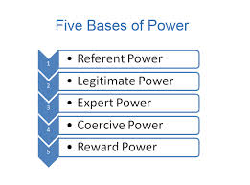
Understanding Power
Source of Power-How People Acquire Power
Most of these are relatively self evident in nature: Five major types-
Expert power: Knowledge is power. Expert power is derived from possessing knowledge or expertise in a particular area.
Reward power: Reward power arises from the ability of a person to influence the allocation of incentives in an organization. These incentives include salary increments, positive appraisals and promotions.
Coercive power: Coercive power is derived from a person's ability to influence others via threats, punishments or sanctions. Coercive power helps control the behavior of employees by ensuring that they adhere to the organization's policies and norms.
Legitimate power: is also known as positional power. It's derived from the position a person holds in an organization’s hierarchy.
Referent power: Referent power is derived from the interpersonal relationships that a person cultivates with other people in the organization.

Slide 6
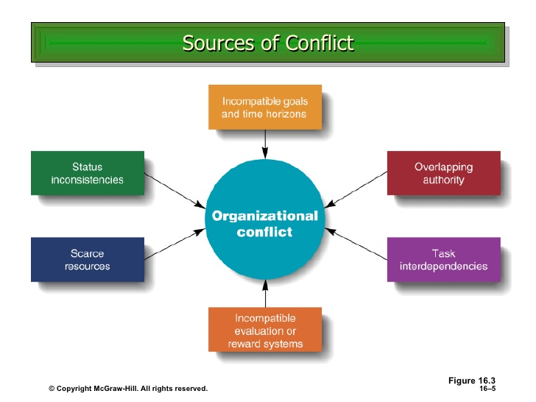

Slide 7
Understanding Power
Power of Motivation
The most desirable source power is of the person whose morality, ethics and sincerity are transparent and obvious. He/she develops immense power precisely due to these characteristics.
Three kinds of power motivation:
Personalized Power
Socialized Power
Achievement or Affiliative Orientation: Affiliative needs are not power needs but sometimes are to dominant they they affect the way in which the individual uses power.

Slide 8
Understanding Power

Slide 9
Nature of power in negotiations
It is the ability to redefine and shuffle the interests to attain goals
The exercise of power entails costs and risks
There is also a distinction between real and apparent power
Power changes over time
Negotiators use power tactics to give an impression of having many alternatives
Power devices are used by negotiators to develop in the opponent, feelings of loyalty, obligation or gratitude
Power additions are ways in which the negotiator adds to the perceptions of his power through additions such as personal charm, prestige and association
Expert power is the power of knowledge that comes through control over information

Slide 10
Use of power in negotiation
He must identify his dependence and the individuals on whom he/she is dependent.
If dependence cannot be transferred, he/she tries to neutralize it.
The higher he/she rises in the organization, the more contacts he/she must nurture with all the stakeholders
A sensible use of power is to choose to fight on your own ground, and not to fight at the same time on many front….it is better to make friends even with those you dislike so that you take on one person at a time.
Many people when they reach high positions, rapidly change their persona.
Buying support from those on whom you depend is not done only with money
**The negotiator use the negotiations to affect the perceptions of his/her opponents by:
Controlling information
Internal collusion

Slide 11
Concession behavior
These are tactical modes of action that manipulate behavior or the understanding of the opponent. A concession indicates to the other party certain intentions and aspirations and can alter the opponent’s intentions or aspirations or actions. From the point of view of signals of power, concession should always be reciprocated.

Slide 12
Dealing with others who have more power
Dancing with elephant with an opponent much bigger than you and highlights ways that lower power parties can deal with the big players in business deals and partnerships, as follow:
Never do an all or nothing deal
Make the other party smaller
Make yourself bigger
Build momentum through doing deals in sequence
Use the power of competition to leverage power
Constrain yourself
Good information is always a source of power
Do what you can to manage the process

Slide 13
Conclusion
The relative power of parties in a negotiation is a key element in the outcome of any negotiation. Power is ultimately a matter of perception and therefore, can be manipulated.
Using power requires an understanding of who your are dependent upon, minimizing dependence, and building and destroying coalitions for and against your or your objective.
The bottom line in using power must be the desire to maintain long-term relationships and to develop a commitment in all parties to the negotiation to implement the agreement. No action can be taken which might jeopardize this bottom line.

Slide 14
