Slide 1
Conflict management
Helen Peng

Slide 2
Brief Contents
Managing Conflict
01
Concept and Importance of Conflict
02
Organization as Network of Relations and Conflicts
03
Nature of Conflict
04
Sources of Conflict
05
Processes and Dynamics of Conflict
06
Classification of Conflict
07
Strategy and Management of Conflict

Slide 3
08
15
Role of Influencing Style in Negotiation
Brief Contents
Managing negotiation
Managing negotiation
09
16
Cross-Cultural Dimension of Negotiation
Planning for Negotiation
10
Strategies and Tactics of
Negotiation
17
Glimpses into Aspects of International Negotiation
11
18
Negotiating Processes
Ethics and Negotiation
12
19
The Third Party Intervention-Litigation/Conciliation/Arbitration
Negotiating with Prospective Employer
13
20
Some Suggested Practices to be Followed in Negotiation
Role of Power in Negotiation
14
Role of Communication

Slide 4
01
DESTINY FREEDOM
Conflict is an inseparable part of our personal and professional lives! There can be different ways to resolve conflict. The most effective way seeks mutual agreement through dialogue and ends in a win-win situation.
Preface

Slide 5
Managing conflict
Part I

Slide 6
01
Concept and importance of conflict
Helen Peng

Slide 7
01
Contents
Introduction
Concept of Conflict

Slide 8
Introduction
better equip you better to manage conflict situations more deeply at your workplace
Conflict is inevitable and universal phenomenon of our individual, team & organizational life.
Think back and recall each succeeding conflict in your life over the years has been increasingly complex.
Conflict has occupied the thinking of man more than any other theme.
Conflict is not confined at the individual level alone but is manifesting itself more and more in organizations.
A survey suggests that the modern man spends over 20% of his/her time handing one form of conflict or the other.
Conflict is everywhere. At a superficial level, conflict can be categorized into “hot” (strong emotions, loud voices, visible tension) and cold (suppressed emotions, tense silence, invisible stress).

Slide 9
01
Leading through conflict-
Effective leaders today must develop the skills for turning these differences into opportunities.
1) Integral vision
5) Conscious conversation
2) System thinking
6) Dialogue
3) Presence
7) Bridging
4) Inquiry
8) Innovation

Slide 10
Concept of conflict
“
Conflict is a situation in which two people cannot agree on the actions that one person takes or that he or she doesn’t want the other to take!
It can be defined as a disagreement between two or more individuals or groups, with each individual or group trying to gain acceptance of its views or objectives over others.
--David L. Austin

Slide 11
01
Concept of conflict
Conflict is universal
Conflict is inevitable
Conflict is normal in our life
Conflict can not be totally eliminated
All conflicts can be managed/resolved
Unresolved conflicts do not disappear by themselves
There can be harmony in conflict
The ability to understand and correctly diagnose conflict is essential to managing it. Thus, we can say that conflict is an absolutely predictable social phenomenon and it should be channeled to useful purpose.

Slide 12
Why management of conflict is necessary?
“
Following are the different steps of managing a conflict:
Understanding and Appreciating Conflict
Eliminating and Avoiding Conflict
Reducing Negative Effects of Conflict
Managing Conflicts for Positive Results- for Individual, Team and Organization

Slide 13
Why management of conflict is necessary?
Positive conflict (functional)
Negative conflict (Dysfunctional)
Analytical thinking
Group cohesiveness
Competition
New ideas
Creativity
Stimulation for change
Identification of weakness
Awareness
Quality decisions
Release of tension
It hinders group performance, High employee turnover, tensions, Dissatisfaction, climate of distress and confrontation.
It is estimated that over 65% of performance problems result from strained relationship between employees and not from defects in individual employees’ skill or motivation.

Slide 14
Why management of conflict is necessary?
Positive consequence
Negative consequences
Lead to new ideas
Stimulates creativity
Motivates change
Promotes organizational vitality
Helps individuals and groups establish identities
Serves as a safety valve to indicate problems
Diverts energy from work
Threatens psychological well-being
Wastes resources
Creates a negative climate
Breaks down group cohesion
Can increase hostility and aggressive behaviors

Slide 15
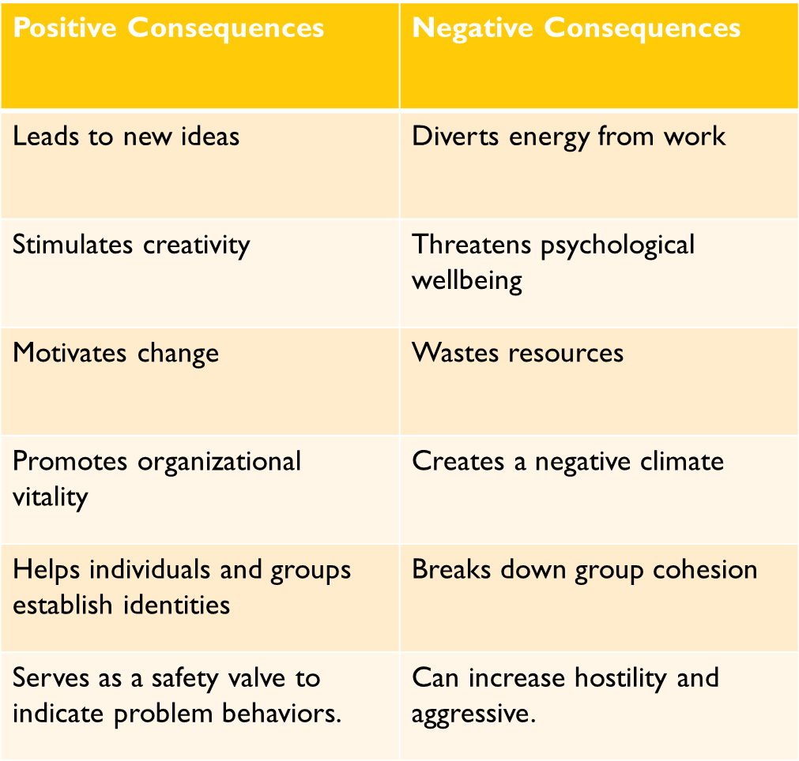
How to differentiate?
Are the parties approaching the conflict from a hostile standpoint?
Is the outcome likely to be a negative one for the organization?
Do the potential losses of the parties exceed any potential gains?
Is energy being diverted from goal accomplishment?
**If the majority of the answers to above are YES, then is dysfunctional.

Slide 16
